Slide 1



Real Estate
Market Analysis
Project Report - Spring 2023
BAN 612 - Data Analytics
Group-3
March 10, 2023

Slide 2




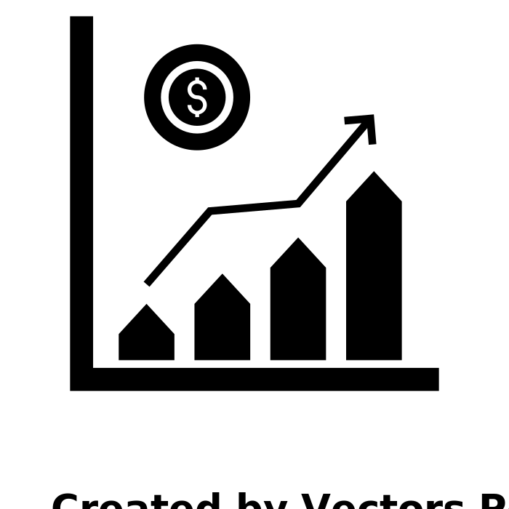





Contents
Team Introduction
Project Overview
Data Collection
Exploratory Data Analysis
Predictive Analysis

Slide 3
Project Team Members
Parthiv Patel
NetId - hk9113
Swati Sharma
NetId - xn2486
Megh Dave
NetId- cc3118
Sam Thomas
NetId - my4704
Akhil
NetId - to6616

Slide 4



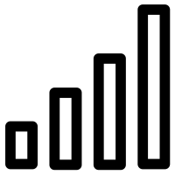
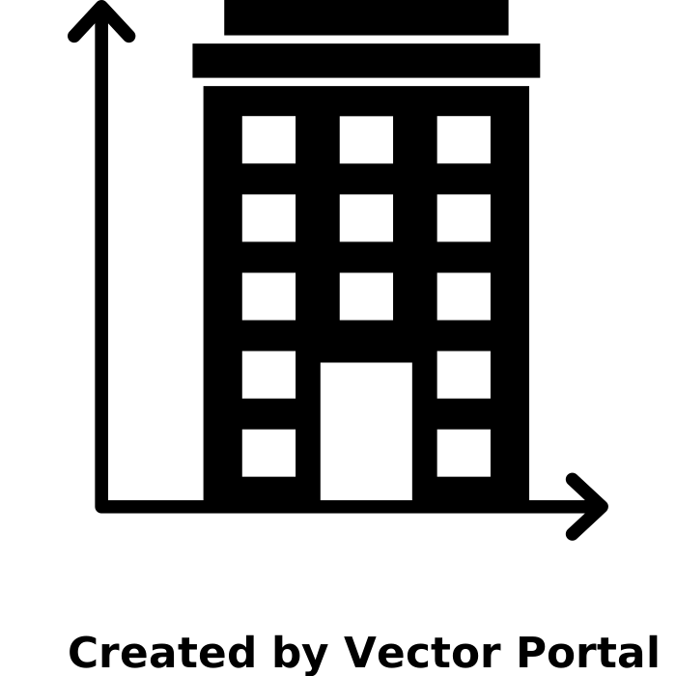
Project Overview
Technologies
Problem Statement
The housing price or rental price in San Francisco Bay Area accelerating at shocking rates. From 2010 to 2017, the median price of a single family home in San Francisco has gone from approximately & 775,000 to $1.5 million. This project presents detail analysis on the real estate in San Francisco Bay area region.
To collect information on more than 600 distinct properties from Redfin Real Estate website
To clean, prepare, organize and handle the missing data, outliers,incorrect record and so on
Prepare a statistical report to analyse the current trend in the market for real estate
Propose several research questions and use visualization techniques to identify the researched questions
Data Resources
Attributes
Redfin Real Estate - https://www.redfin.com
Counties
Price
Status
Area

Slide 5

Part 1:
Data Collection

Slide 6







Flowchart - Web Scraping Steps
Selenium Automation
Identify the type of data
Data Collection
Convert the data into
Bot opens the website and locates the required attributes
Extracts the required attributes
Repeat the same process till the last page
Attribute Classification
Identify the size of data
HTML Parser
Identify the type of data
Data Collection
Convert the data into
Use of custom header to avoid html content backlog
Identify html tags for required attributes
Extract the tag’s content and repeat the same process for all pages
Attribute Classification
Identify the size of data

Slide 7
Part 2:
Data Cleaning

Slide 8
Data Cleaning - Before vs After
Data Cleaning Process:
We extracted over 1200 data from six different counties having six different pages. After cleaning, the total data boiled down to around 430.
Data is cleaned by removing null values, by making function to split all alphanumeric data into categorical and quantitative columns for exploratory analysis and prediction.
Column Attributes | Before Cleaning | After Cleaning
Price | 598,000 | 598000.0
Lot_Area | 5,200 Acres | 5200.0
HOA Due | $449 | 449.0
Redfin_estimate | 498,286 | 498286.0

Slide 9
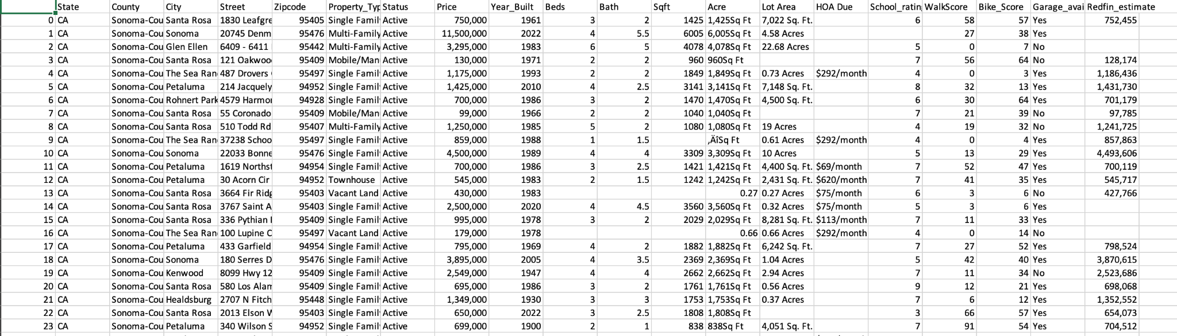
Final Result

Slide 10
Part 3:
Exploratory Data Analysis

Slide 11
Problem Statement For EDA
What are the cities with the highest and lowest average price per square feet per county?
What is the distribution of houses based on the number of bathrooms?
What is the distribution of houses based on the number of bedrooms?
Can you provide a report on the sales price distribution?
How do walk score and bike score affect house prices?
How does school rating affect house prices?
Distribution of property type based on counties. Is there any correlation between the different features of houses in the dataset?
Build regression models to predict the prices of properties and compare your prediction with redfin's estimates and see which one is better or closer to real values.

Slide 12
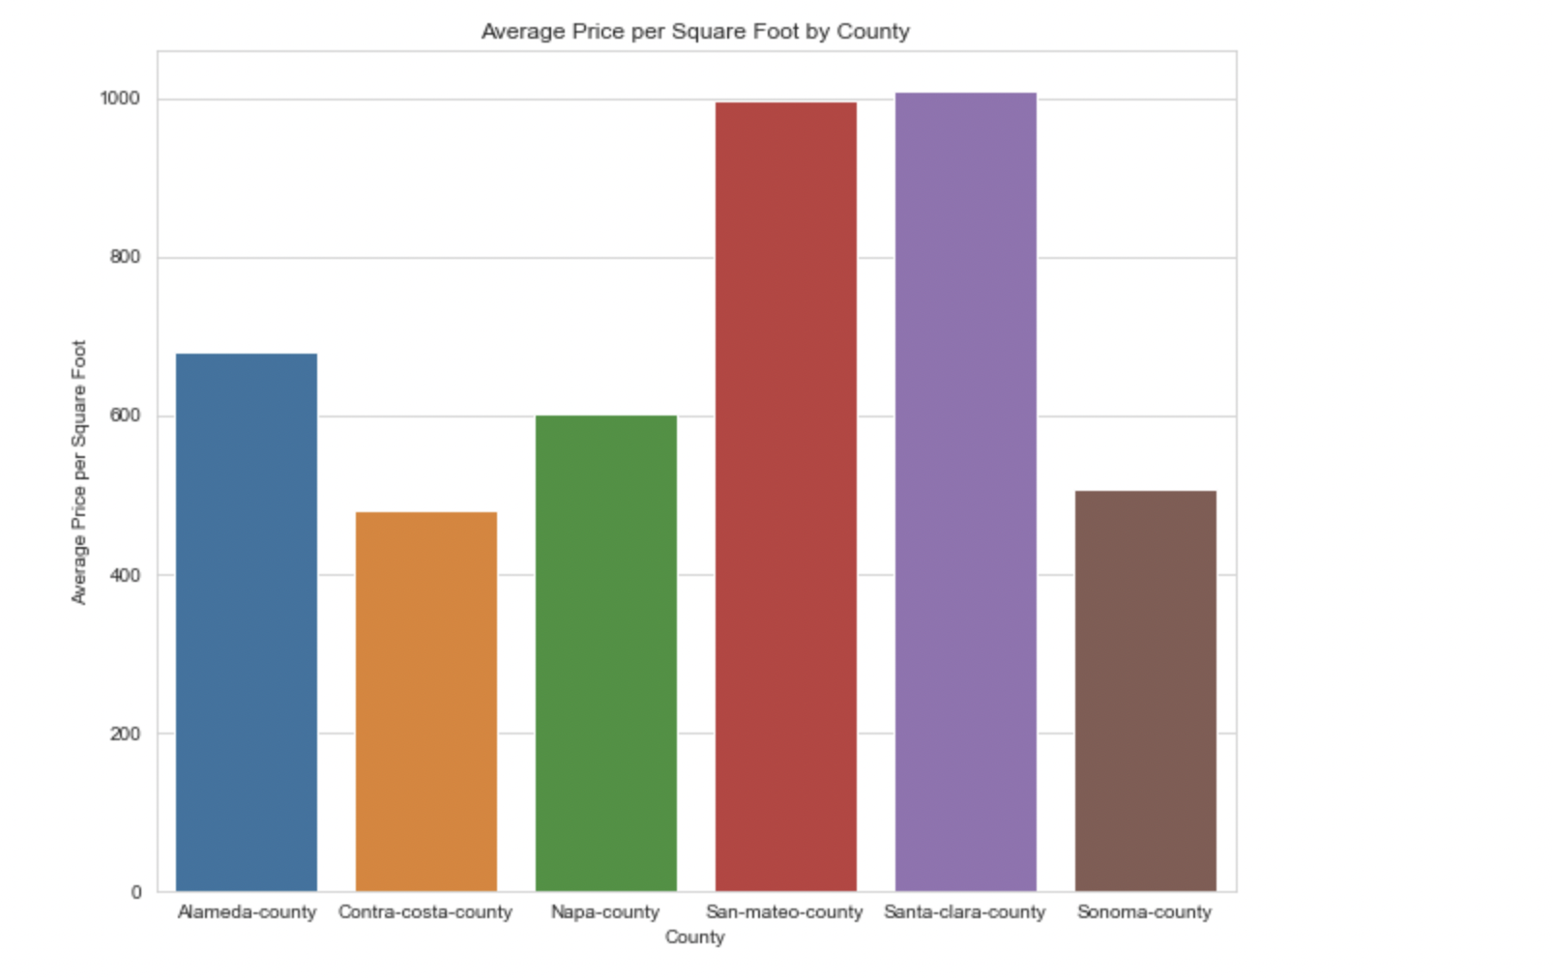
Average Price Per Square Feet by County
Santa-clara county has the highest per sqft price in the bay area which is followed closely by san-mateo county
Contra-costa county has the lowest per sqft price in the bay area which is less than half the price per sqft of Santa-Clara or San-Mateo counties.

Slide 13
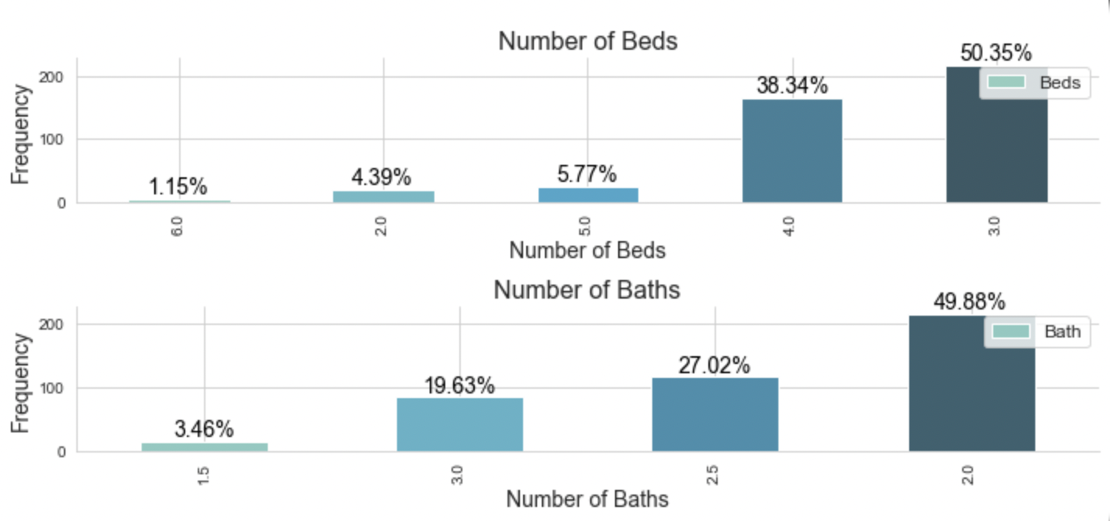
Distribution of Houses based on Number of Beds & Baths
Houses with 3 bedrooms are the most common among the listings at over 50%. Additionally, houses with 2 baths are also highly frequent in our data with almost half of all listings.
Least in numbers are apartments with 6 bedrooms and 1.5 baths

Slide 14
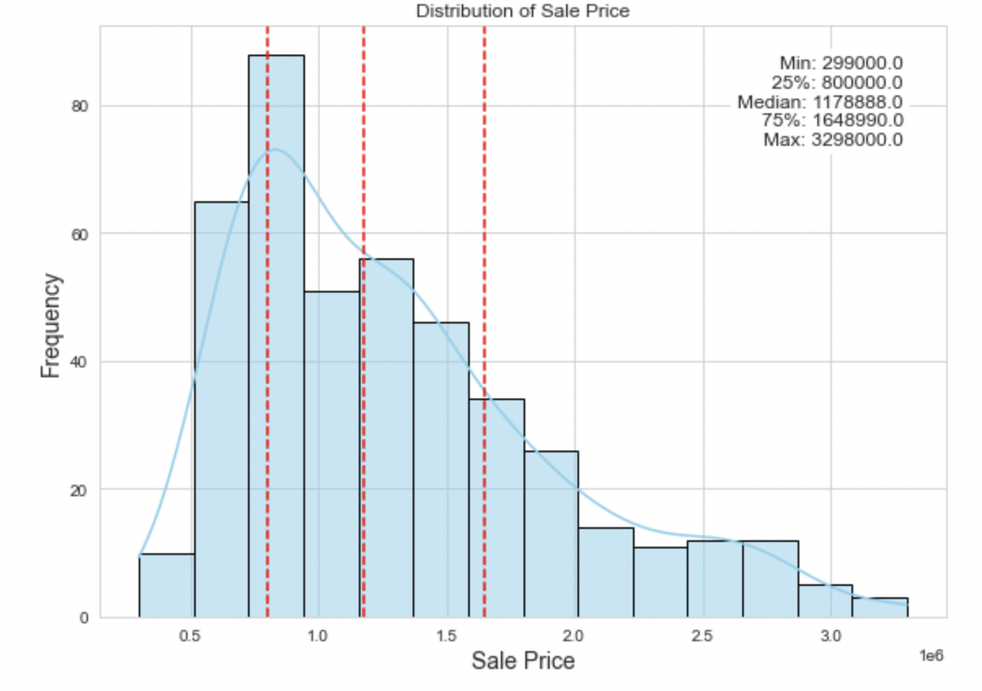
Distribution of Sales Price
The majority of data is concentrated towards the lower end of the distribution (more data points having lower sales prices).
The distribution is skewed to the right.
The upper end of the distribution has more extreme values than the lower end (some extreme higher sales prices).
The mode is less than the median, which in turn is less than the mean.

Slide 15
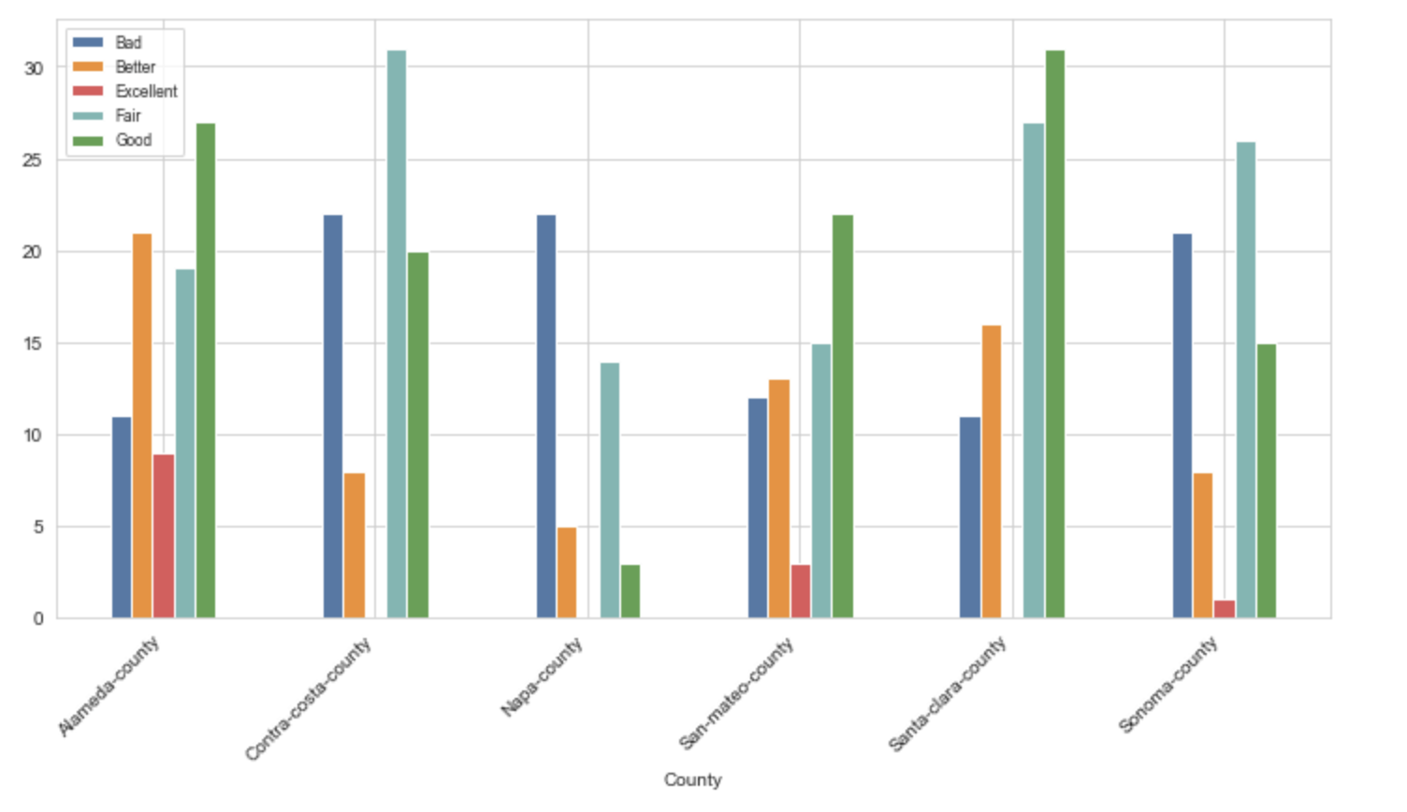
Walkscore Distribution
The Walkscore distribution varies significantly across counties.
Santa Clara County has the highest frequency of Good walkscore indicating the most walkable county in the region.
Napa County has the highest frequency of Bad walkscore, indicating the least walkable county in the region.
Contra Costa County has a fairly good walkscore distribution.
This suggests that Contra Costa County is a viable option for those who prioritize walkability in their desired neighborhood.

Slide 16
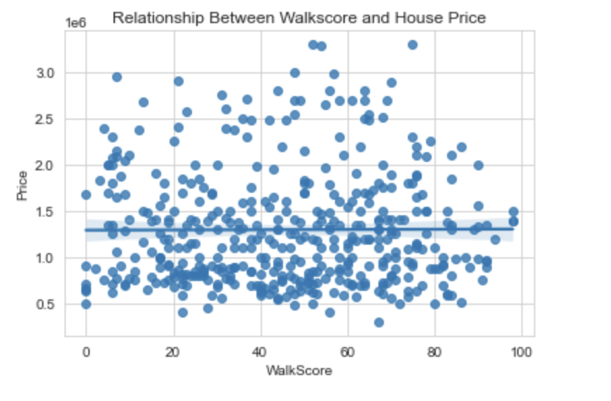
Walkscore vs House Prices
A correlation value of 0.004694 means that there is a very weak positive correlation between Walkscore and House Price.
This value is close to zero, which means that there is almost no linear relationship between the variables.

Slide 17
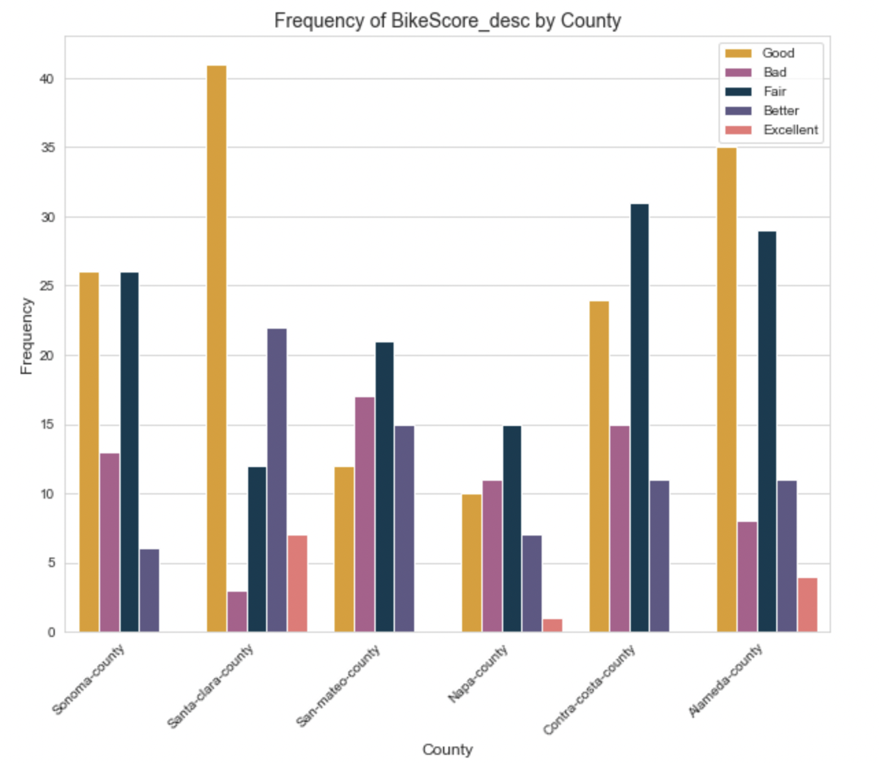
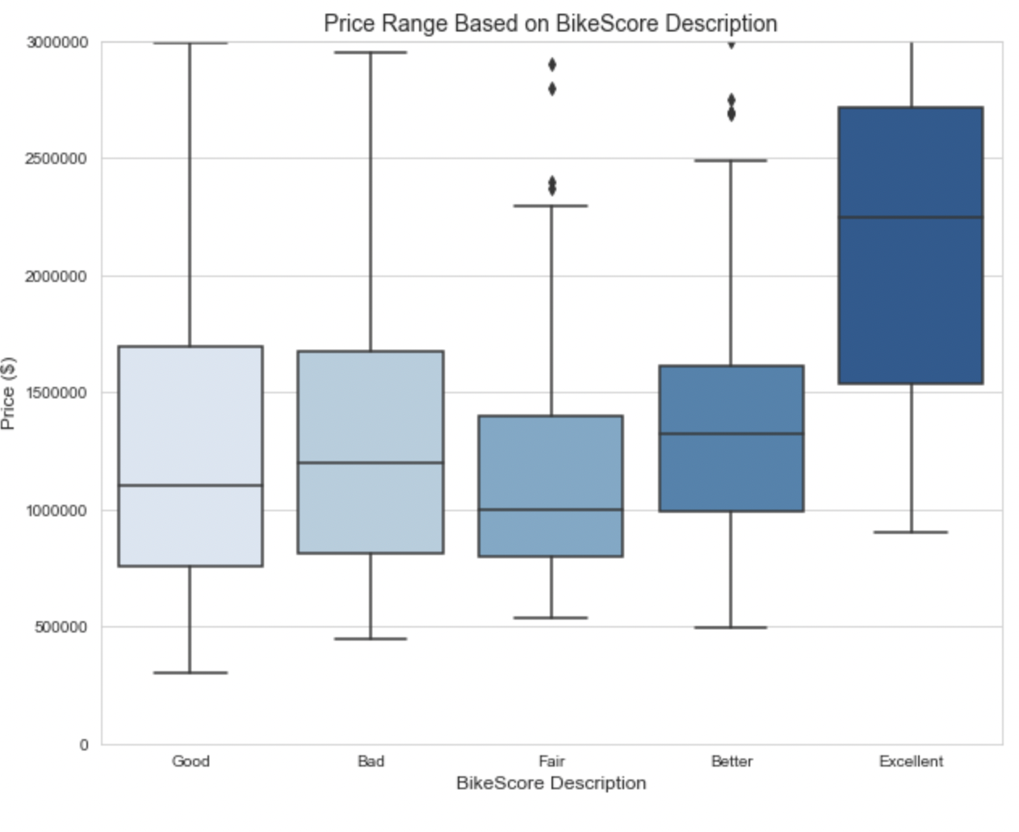
Distribution of Bike Score

Slide 18
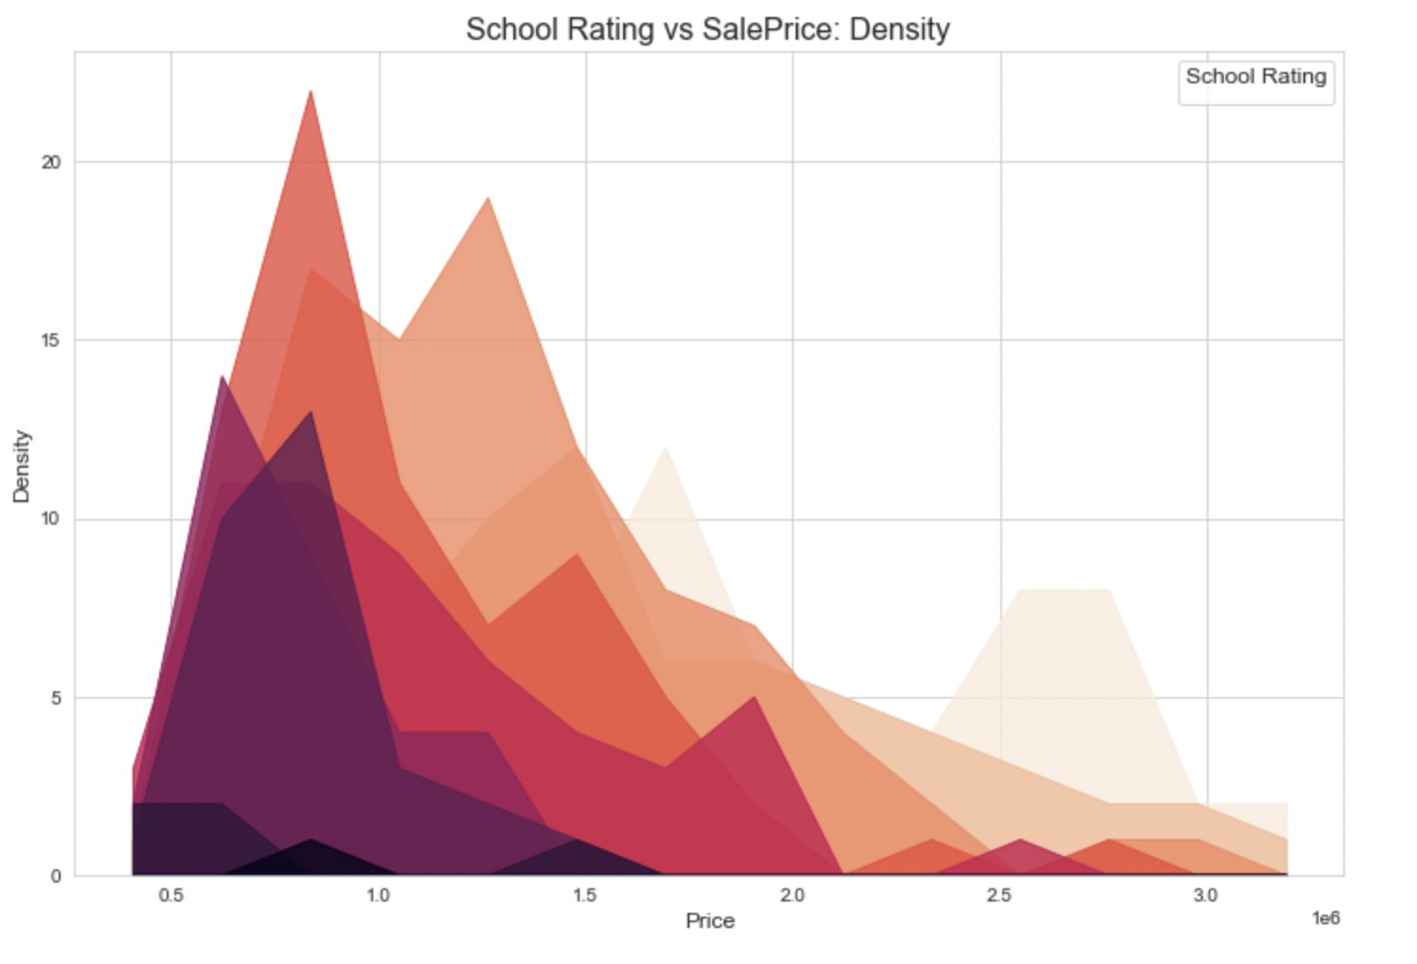
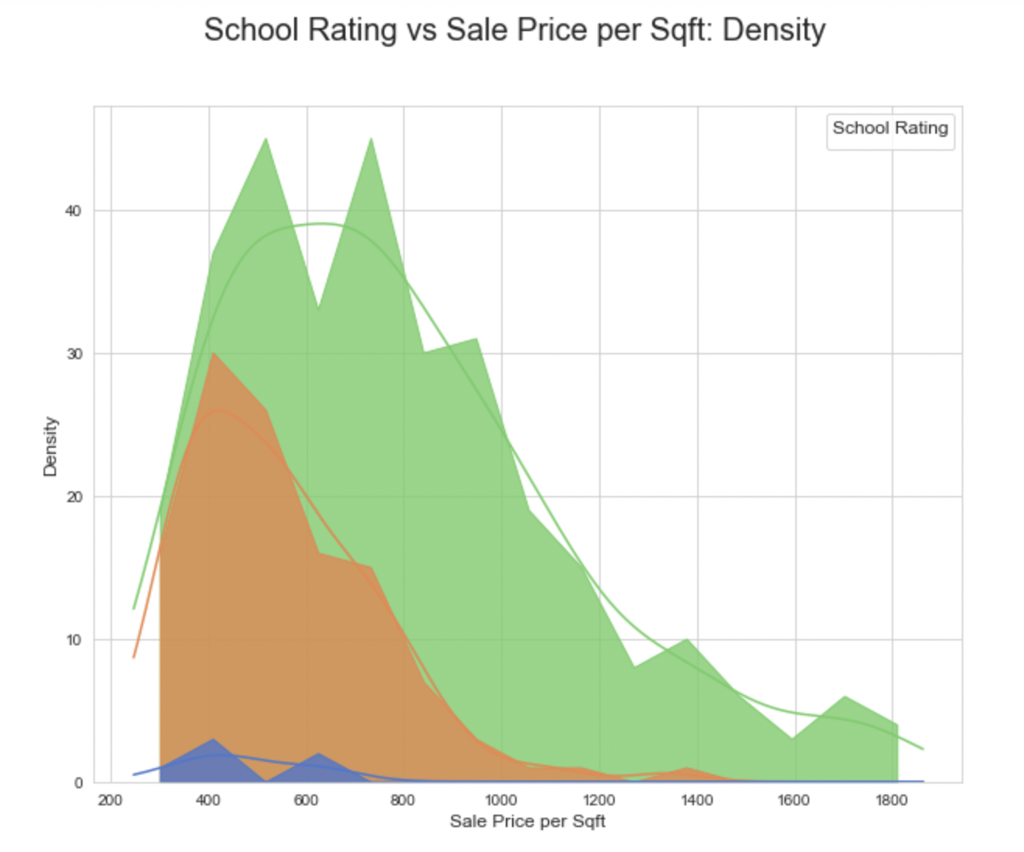
Impact of School Ratings on House Prices

Slide 19
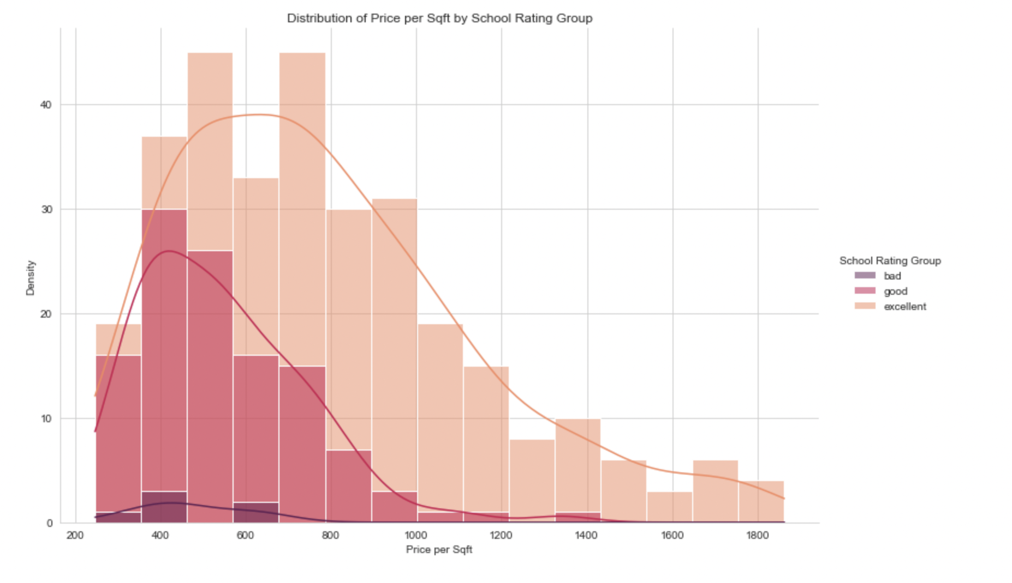
Impact of School Ratings on House Prices
The prices of houses will vary based on the school rating group they fall into. Generally, houses in the "Excellent" school rating group will have the highest prices, followed by the "Good" group, and then the "Bad" group.
School ratings on a scale of 0-10 will be categorized into three groups: "Bad", "Good", and "Excellent".
School rating is an important variable in determining house prices, as houses in areas with better schools are typically more desirable and command higher prices.

Slide 20
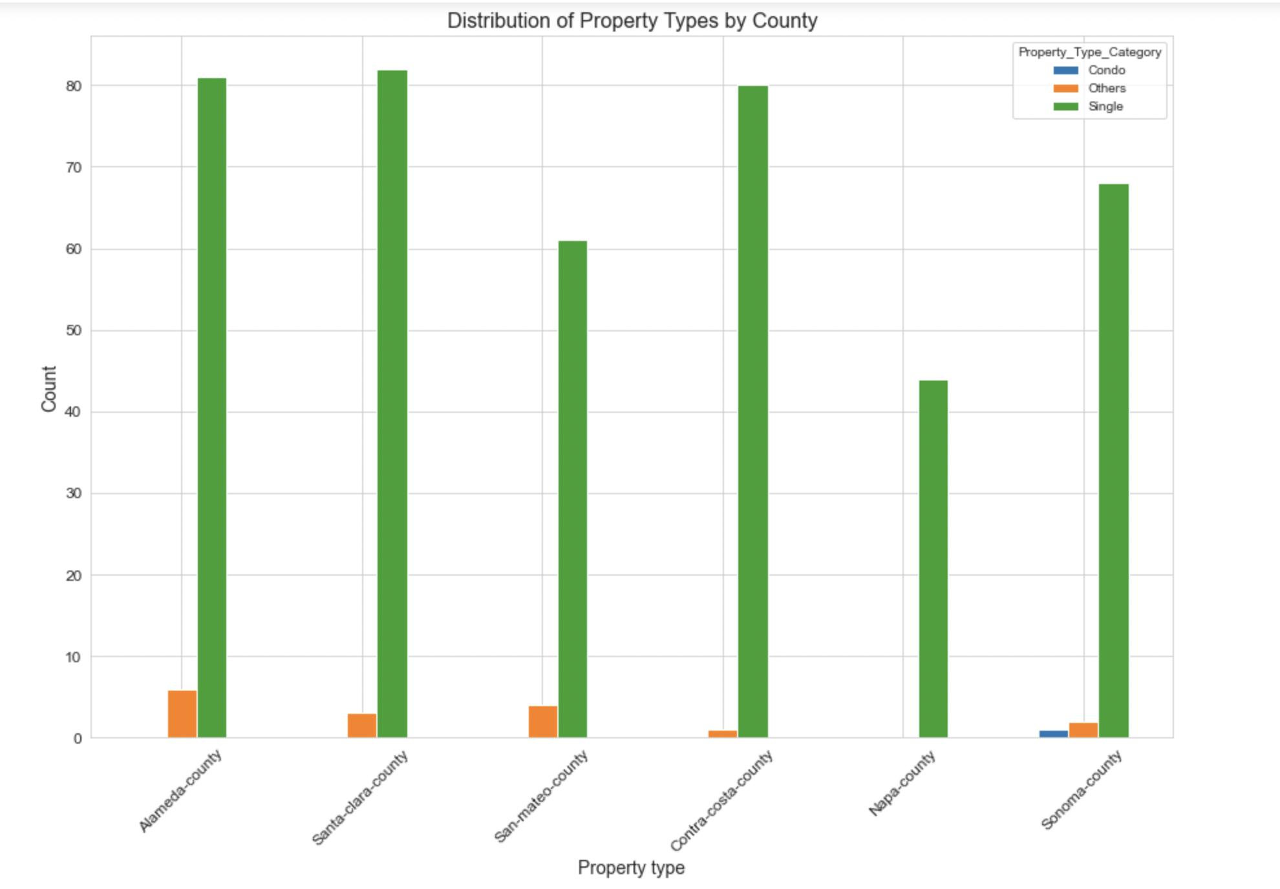
Distribution of Property Type based on Counties

Slide 21
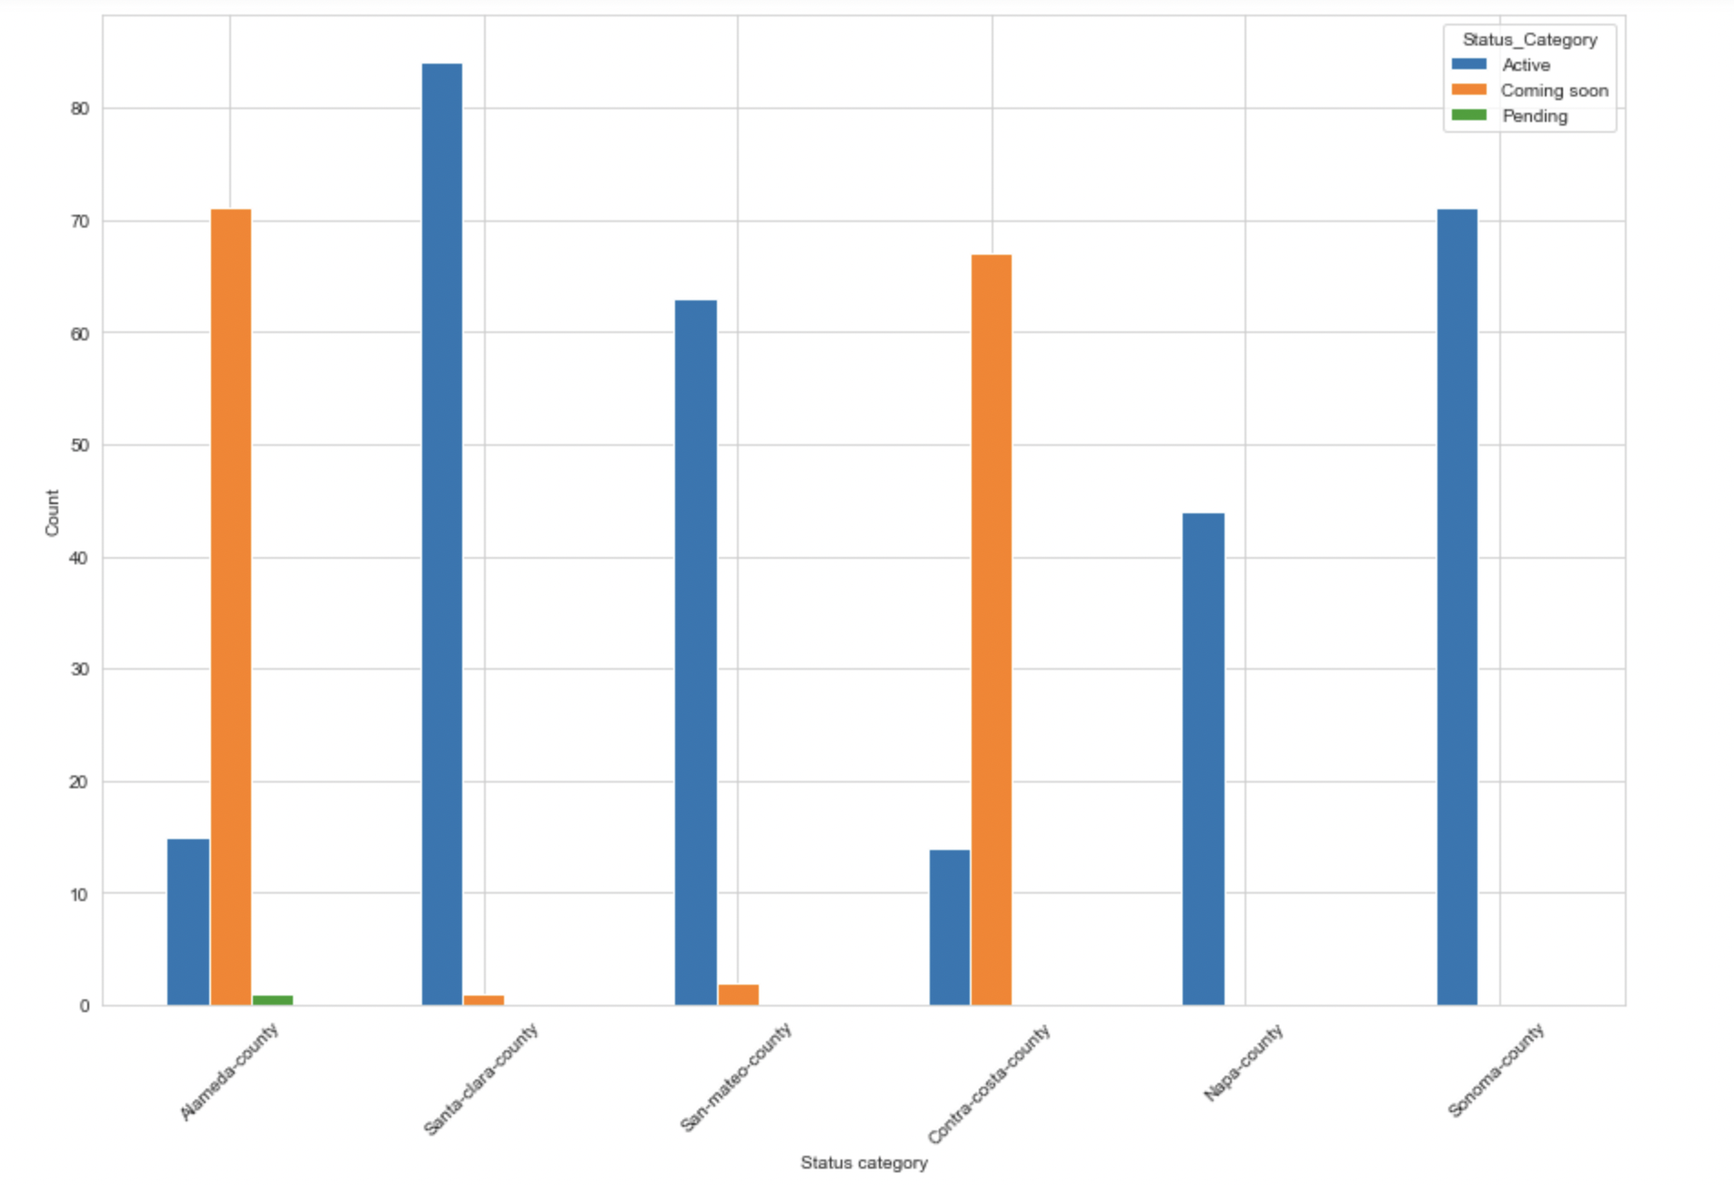
Distribution of Property Status across Counties

Slide 22
Part 4:
Predictive Analysis

Slide 23
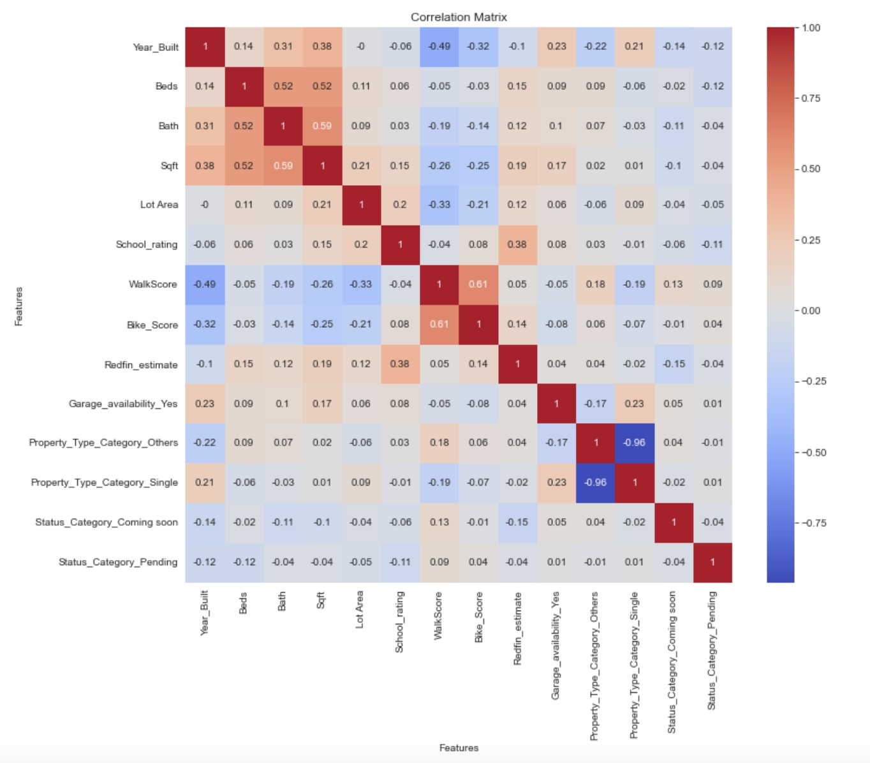
Correlation Matrix
There is a very strong negative correlation between property type - others and property type – single.
Stronge positive correlation is observed between walk score and bike score

Slide 24
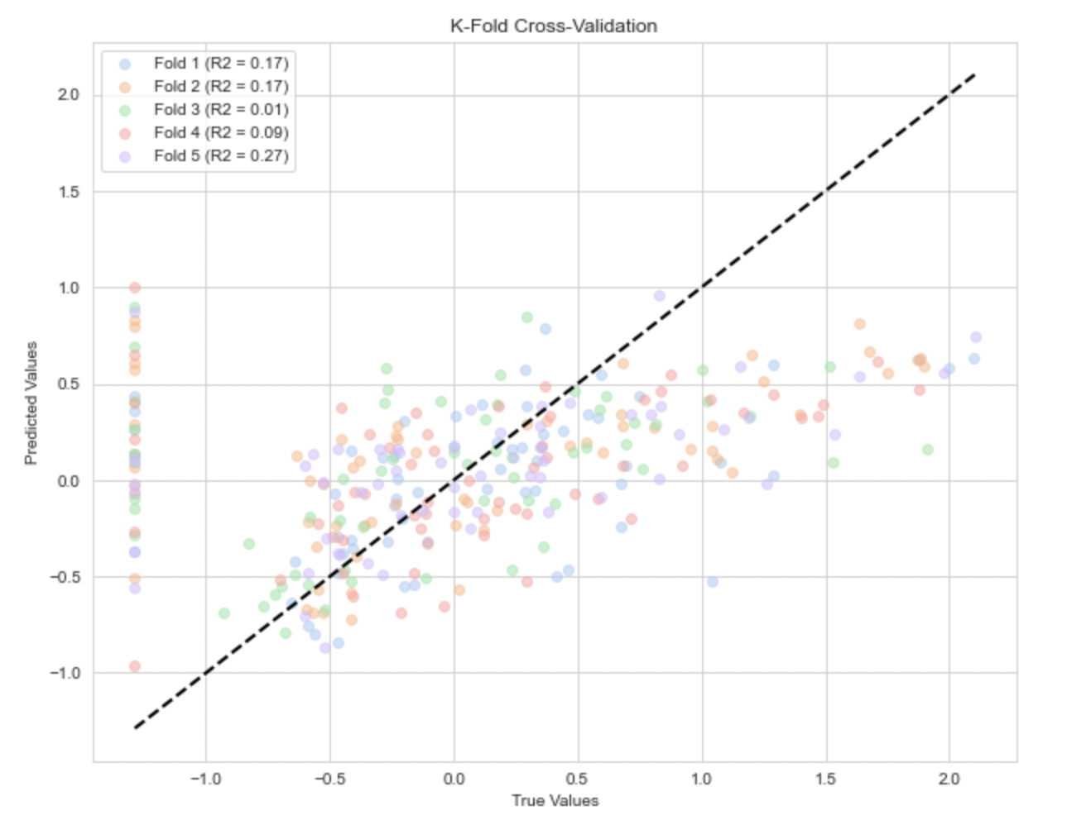
Analyzing the regression model with K-fold Cross-Validation

Slide 25
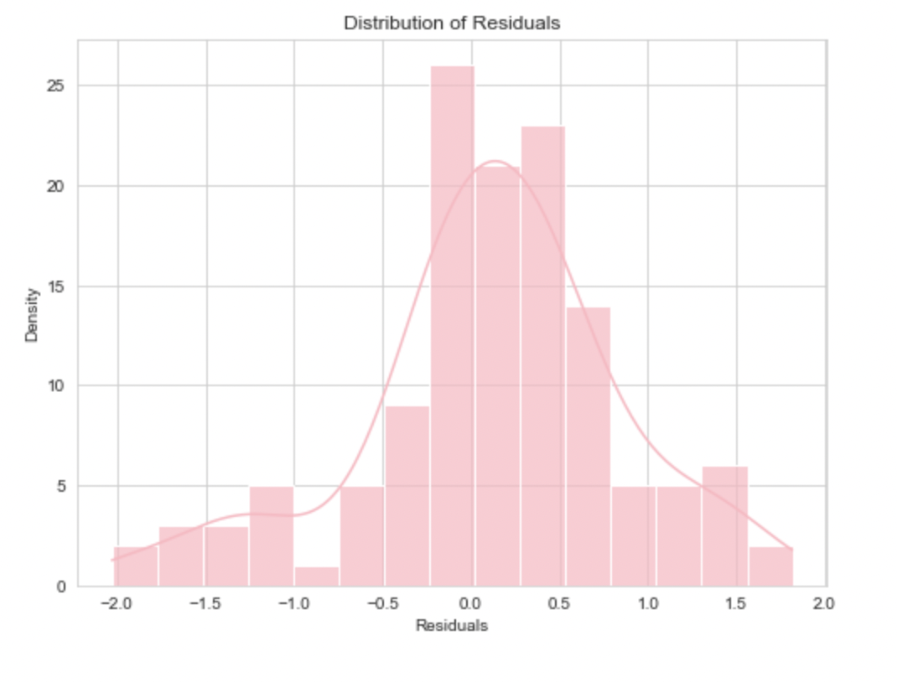
Analyzing the regression model with K-fold Cross-Validation

Slide 26
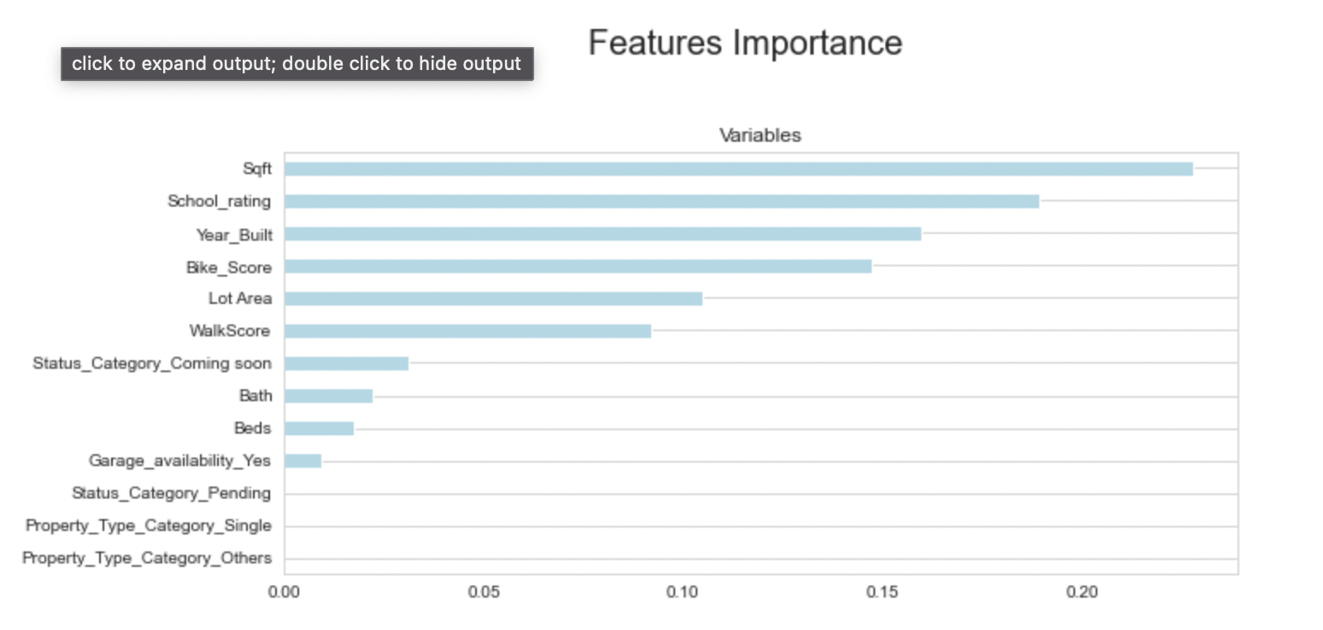
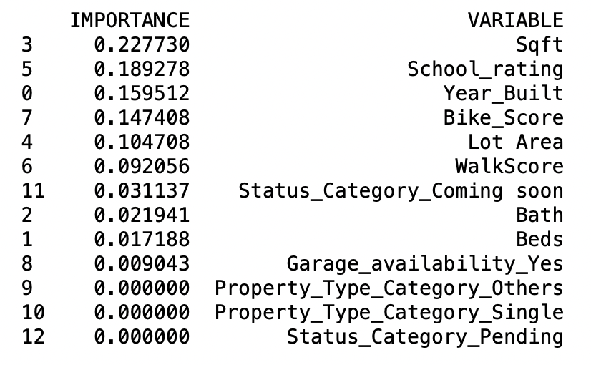
Linear Regression with Important Features

Slide 27
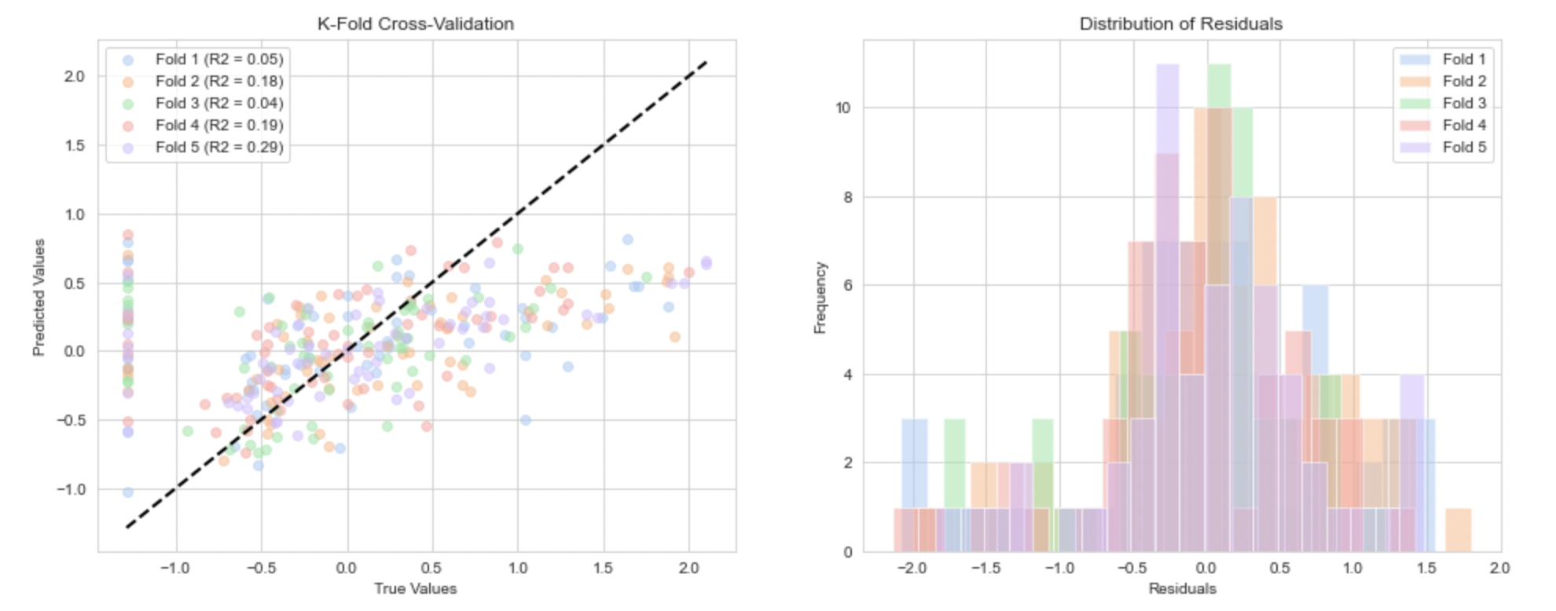
Analyzing the regression model with K-fold Cross-Validation

Slide 28
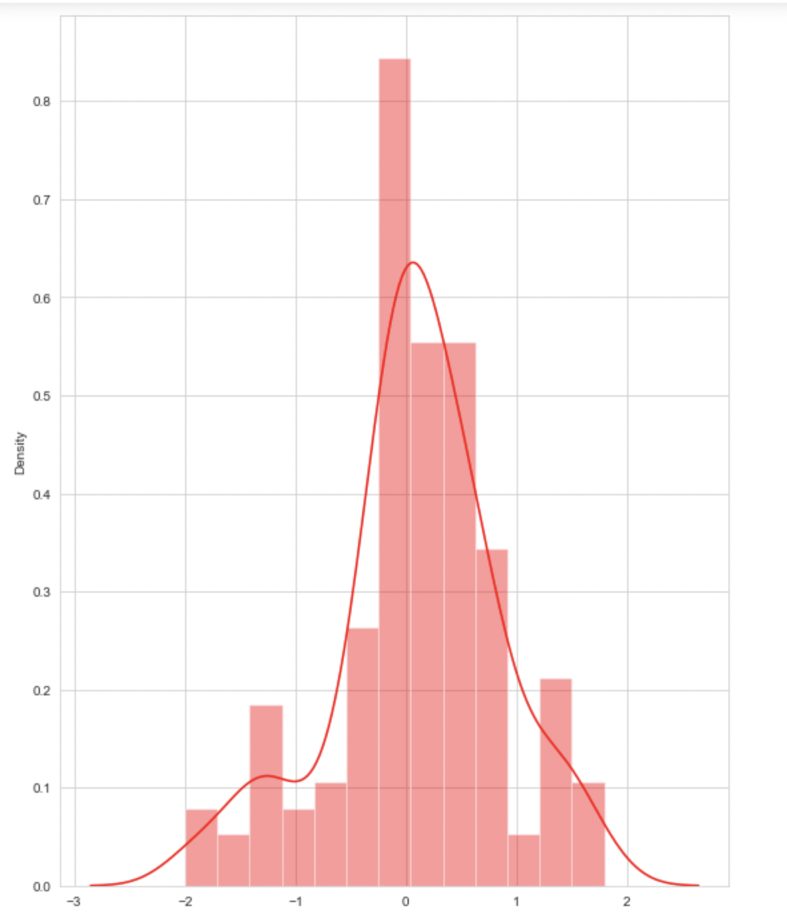
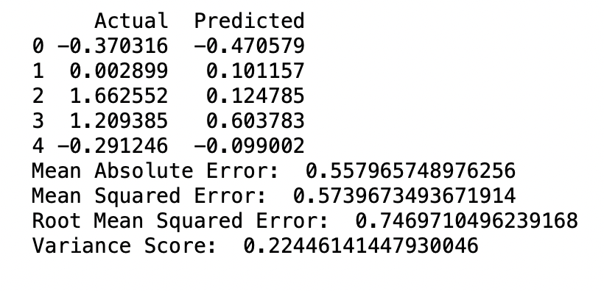
Residuals

Slide 29
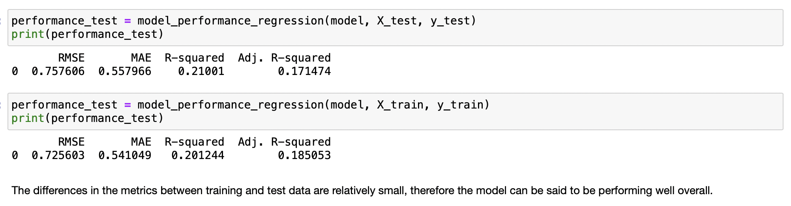
Random Forest Regressor

Slide 30
Thank You

